Slide 1

Code Hustlers Solution Type: Website , App(in Progress – Will be under Future Aspect)
Veer Yadav -Team Leader
Rahul Sharma -Team Member
Lakshay Singhal -Team Member
Gursharan -Team Member
Notes:
Korrie

Slide 2
The Opportunity
A recent UNICEF and WaterAid report highlights a concerning reality: over one-third of girls in South Asia are absent from school during their menstrual periods.
This absence is primarily attributed to the lack of accessible toilets and sanitary pads in schools, coupled with inadequate education about menstruation.
Recognizing menstrual hygiene as a global public health and human rights issue, the UN underscores the alarming statistic that 1.2 billion women worldwide lack access to basic sanitation and hygiene.
In response, our commitment is to eradicate Period-Poverty and dismantle the enduring stigma by empowering girls through education and healthcare initiatives.
Notes:
Korrie
updated 7/21

Slide 3
Solution
We aim to revolutionize women's healthcare by offering personalized feedback, analysis, mood tracking, and period cycle monitoring for women who face insecurities and enduring social stigma.
Our platform enables users to meticulously Track their Period Cycle, receive insightful Mood Analysis, and access information about nearby hospitals and gynecologists for their medical needs.
Through our platform, users can effortlessly Schedule Appointments with doctors and avail of remote consultations.
Additionally, our blog section, titled Period Pulse, serves as a space for individuals to share informative content, challenging stereotypes, and contributing constructively to societal awareness.
This section empowers each girl to showcase her knowledge and make a positive impact on society.
Notes:
Korrie
updated 7/21

Slide 4
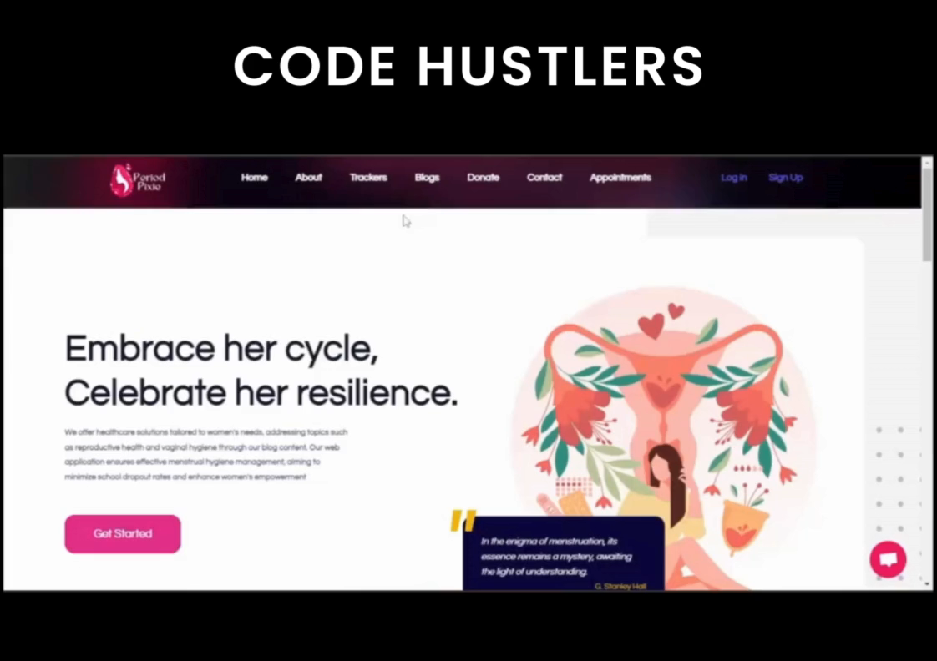
Demo
Link : Code-Hustlers-Project-Video
Notes:
Korrie
updated 7/21

Slide 5
Takeaways
Q-1) What do you recommend your audience stop/start doing?
Stop:
Neglecting Health: Stop ignoring menstrual health due to stigma or misinformation.
Using Unreliable Sources: Avoid inconsistent or inaccurate health information.
Start:
Using Digital Tools: Track period cycles and receive personalized health insights with our platform.
Engaging with Our Community: Share experiences and knowledge on the Period Pulse blog to break down stigmas.
Scheduling Health Check-ups: Use our platform to book appointments and consultations regularly
Notes:
Korrie
updated 7/21

Slide 6
Takeaways
Q-2) What can be done without you?
Manual Tracking: Use calendars or journals to track periods.
Researching Health Info: Seek information from books or the internet.
Scheduling Appointments: Book and visit doctors directly without the platform.
Q-3) How could your solution speed up the process, simplify it, or even make it cheaper to get there?
Speed Up | Simplify | Cheaper
Quick Info Access: Get instant health insights and mood analysis. | User-Friendly: Easy tracking, mood analysis, and finding medical facilities. | Remote Consultations: Save on travel and consultation fees.
Easy Appointments: Schedule appointments quickly online. | Centralized Hub: All health-related tools in one place. | Preventative Care: Early warnings to avoid costly health issues. & Community Support: Free access to shared knowledge on Period Pulse.
Notes:
Korrie
updated 7/21

